Slide 1
AN OVERVIEW OF TITLE I READING
New Kent Elementary School
Notes:
NOTE:
To change the image on this slide, select the picture and delete it. Then click the Pictures icon in the placeholder to insert your own image.

Slide 2
What is Title I?
It is a federally funded grant
It is one of the oldest and largest federal program supporting education. It is part of the Elementary and Secondary Education Act and the Every Student Succeeds Act (ESEA).
The most recent data shows that in 2015-2016, “more than 55,906 public schools across the country used Title I funds to provide additional academic support and learning opportunities to help children master challenging curricula (material) and meet state standards.”
More information can be found at: (or do an internet search for the words “Title I”)
https://www2.ed.gov/programs/titleiparta/index.html#targetText=Title%20I%2C%20Part%20A%20(Title,meet%20challenging%20state%20academic%20standards.

Slide 3
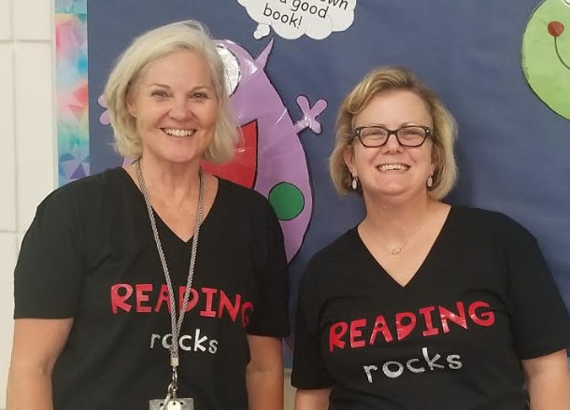
Title I Staff at NKES
Debbie Allen Reading Specialist | Erin Teger Reading Specialist
Christina Carden Paraprofessional

Slide 4
What Will it Look Like
Our school has a School-Wide Title I program. Any student who demonstrates a need for extra support in reading can meet with a Title I teacher or benefit from any resources Title I may have to share with your child’s classroom teacher.
The majority of Title I instruction will take place in your child’s classroom during their scheduled reading block. At the same time, the classroom teacher is meeting with small groups of students. Some students may be pulled out of the classroom to work with a specialist as needed in a Title I classroom or another part of the school building. This is additional support and will not cause them to miss any new or important instruction or activities in the classroom.
All reading events this year offered through Title I are open to all families in the school, not just families of students specifically working with a Title I Teacher.

Slide 5
Title I Instruction
Instruction is typically 5 days a week, but we do have cases where instruction is only on an as needed basis and those students may only see the Title I Teacher a few days/weeks in a month.
One program we currently use to guide instruction is Fountas and Pinnell’s LLI (Leveled Literacy Intervention). The goal of this program is to bring students closer to grade level expectations.
The components:
15-20 minutes, five times per week
Daily fluency, phonics, phonological awareness, comprehension & writing instruction and practice
Weekly data collection to meet student needs and monitor progress

Slide 6
Title I Instruction
Orton Gillingham (O.G.)
Currently both Reading Specialists are trained in Orton Gillingham.
This is currently a statewide initiative to train Virginia’s teachers in best phonics practices.
O.G. is a multisensory approach that targets specific phonics and spelling rules to help students who are behind and have not responded to other approaches.
Both LLI and O.G. are highly researched and highly effective.

Slide 7
How Can You Help Your Child at Home?
Read with them every night for 20-25 minutes
Help your child visualize the story in their mind like a movie.
Have your child retell the story with character, setting, problem, solution .
Ask questions about what they’re reading.
Would you be friends with the main character?
You didn’t like this book - What would you change?
How would you change the ending?
It’s okay to read books again or even read books that seem “too easy”. They can even read a magazine. Any reading is better than no reading at all! Re-reading and “easy” reading helps with FLUENCY (speed, expression, phrasing)

Slide 8
Helpful Resources
Scholastic Book Wizard - https://www.scholastic.com/teachers/bookwizard/ Search for books by subject, grade level, genre or reading level. Overdrive App & RB Digital App & Website - Check out books from local libraries using your phone or tablet. http://heritageva.oneclickdigital.com/ ABCYa - http://www.abcya.com/ Starfall - http://www.starfall.com/ Education World - https://www.educationworld.com/a_tech/archives/readingmachine.shtml - Reading Games by Grade Level Reading Rockets - Parent resources to help their child with reading. http://www.readingrockets.org/

Slide 9
Events
FALL
Back to School Night- parents came and got information and resources about Title 1.
Help Desk- Parents were given resources their child needed extra support in after conferencing with their child’s teacher.
WINTER
One Book, One School- Look for information to come.
SPRING
Bingo for Books

Slide 10
Contact Information
Erin Teger, Reading Specialist
eteger@nkcps.k12.va.us
Debbie Allen, Reading Specialist
dallen@nkcps.k12.va.us

